Slide 1
Networking and HTTP

Slide 2
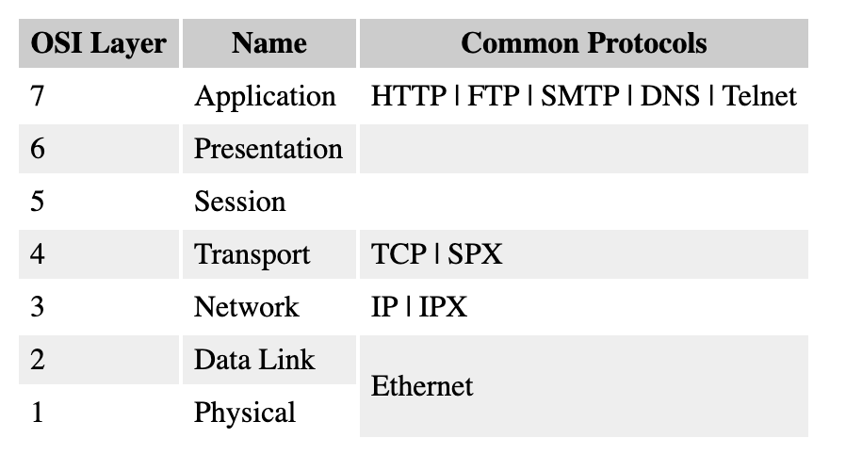
Open Systems Interconnection (OSI)

Slide 3
Open Systems Interconnection (OSI)
Ethernet (Physical/Data Link Layers)
IP/IPX (Network Layer)
TCP/SPX (Transport Layer)
HTTP, FTP, Telnet, SMTP, and DNS(combined Session/Presentation/Application Layers)

Slide 4
Hyper-Text Transfer Protocol (HTTP)
Transport protocol TCP (default port number 80)
Handling user requests on web resources (objects)
Resources encoding
MIME---Multipurpose Internet Mail Extension
--- encodes the data format
--- a MIME type is attached to each resource
URL: Uniform Resource Locator
Describe the location of a resource

Slide 5
HTTP
Transaction oriented
--- client: request message
--- server: response message
Stateless protocol
--- Does not maintain state info across multiple transaction

Slide 6
HTTP
Messages
Request
Response
Method Request URL HTTP version
Accept: text/* Host: www.mysite.com
HTTP version State Code Status
Content-type: e.g. text/html Content-length: 18
Body

Slide 7
HTTP
Methods
Describe the requested action from the server
There are 7 methods
Not all servers implement all methods
Extensible---more additional methods can be defined
Most commonly used methods
GET: request a resource from the server
HEAD: like GET, but only the response header are sent (no body)
PUT: deposit a resource on the server
POST: send data to the server for processing (typically used with HTML forms and data are typically forward to applications)
DELETE: delete a resource on the server

Slide 8
HTTP
Response codes:
Informational status codes: 100-199
Provide additional information (e.g. 100 continue)
Success status codes: 200-299
Indicate successful request completion (e.g. 200 ok)
The requested resource is in the response’s body
Redirection status code: 300-399
Indicates that the requested resources has been moved
E.g. 301 Moved Permanently: Requested object has been moved permanently, the new URL is specified in location header of the response message. The client will automatically retrieve the new URL

Slide 9
HTTP
Response code
Client error status codes: 400-499
Indicates client-side error
400 Bad Request: malfunction HTTP request
401 Unauthorized: Authorization is needed before resource can be accessed
404 Not Found: The requested document does not exist on this server
Server error status code: 500-500
Indicate server-side error
500 Internal Server Error
501 Not implemented
505 Version not supported

Slide 10
HTTP
Cookies
HTTP is stateless
a small piece of data stored on the client side (<name>=<value> pairs)
Session cookies
Permanent cookies

